Slide 1


Lecture 6.3 – CLIP and Latent Diffusion
Generative AI Teaching Kit

Slide 2
This lecture
Recap on Diffusion Models
Latent Diffusion Models
Text-Image Embeddings: CLIP
Stable Diffusion and SOTA
Future: Video Generation
Wrap Up

Slide 3

The NVIDIA Deep Learning Institute Generative AI Teaching Kit is licensed by NVIDIA and Dartmouth College under the
Creative Commons Attribution-NonCommercial 4.0 International License.

Slide 4
Recap: Diffusion Models

Slide 5
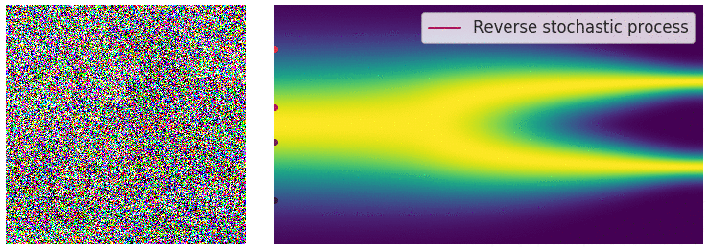
Diffusion Models
In the last lesson we introduced Diffusion Models as a new wayto generate data using the reverse diffusion process.
With diffusion models, we can generate images from noise using a learned diffusion model
Notes:
https://yang-song.net/blog/2021/score/

Slide 6
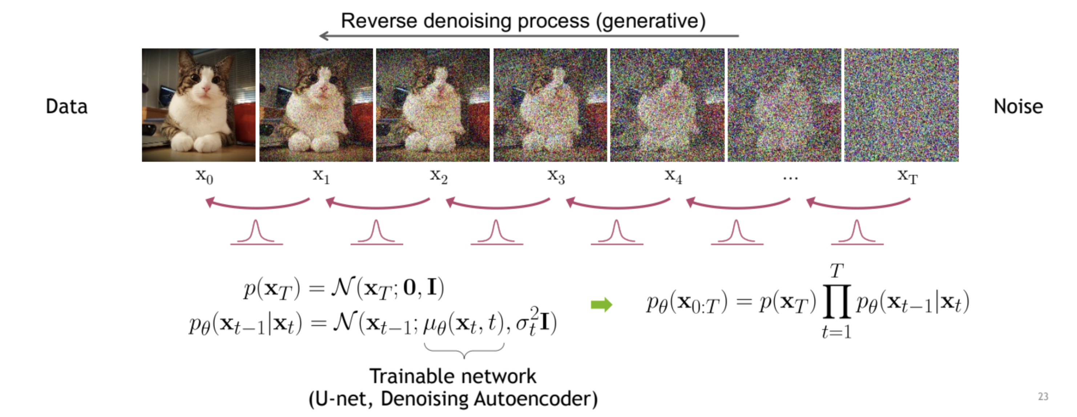
Diffusion Models
A classical diffusion model predicts the noise in the images at each “timestep” and slowly reveals the image
A neural network is trained to predict the noise to be removed at each stage using a timestep as a guide
However, this classical model cannot take any input other than the noise and is slow to generate images.
Notes:
https://cvpr2022-tutorial-diffusion-models.github.io/

Slide 7
Latent Diffusion Models

Slide 8
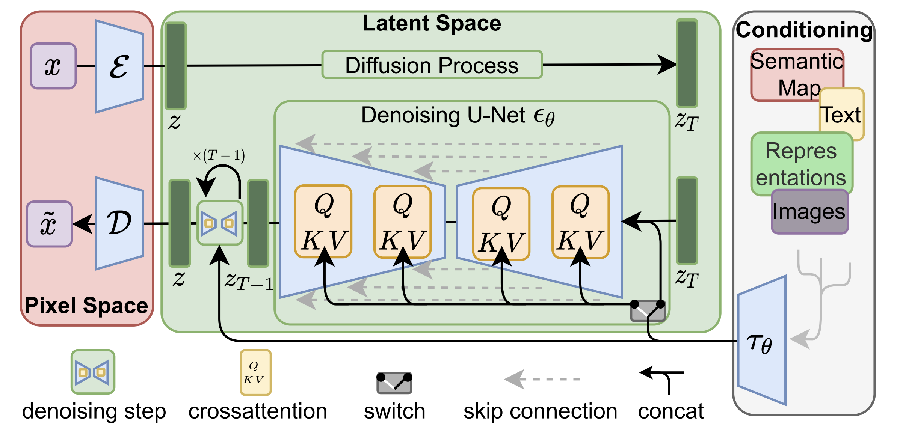
Latent Diffusion Models
What if we perform the diffusion process on the latent space instead of the images?
Latent Diffusion Models
Have access to an efficient, low-dimensional latent space
High-frequency, imperceptible details are abstracted away.
Focus on the important, semantic bits of the data
Train in a lower dimensional
Computationally much more efficient space
Notes:
https://arxiv.org/pdf/2112.10752

Slide 9
Conditional Generation with LDM
The latent space abstracts out the specific form of the data
This allows for conditioning of generation using:
Text
Semantic Maps
Images
etc.
Essentially any data can be converted to the latent space and the attention mechanism will inform the reverse diffusion process
Notes:
https://arxiv.org/pdf/2112.10752

Slide 10
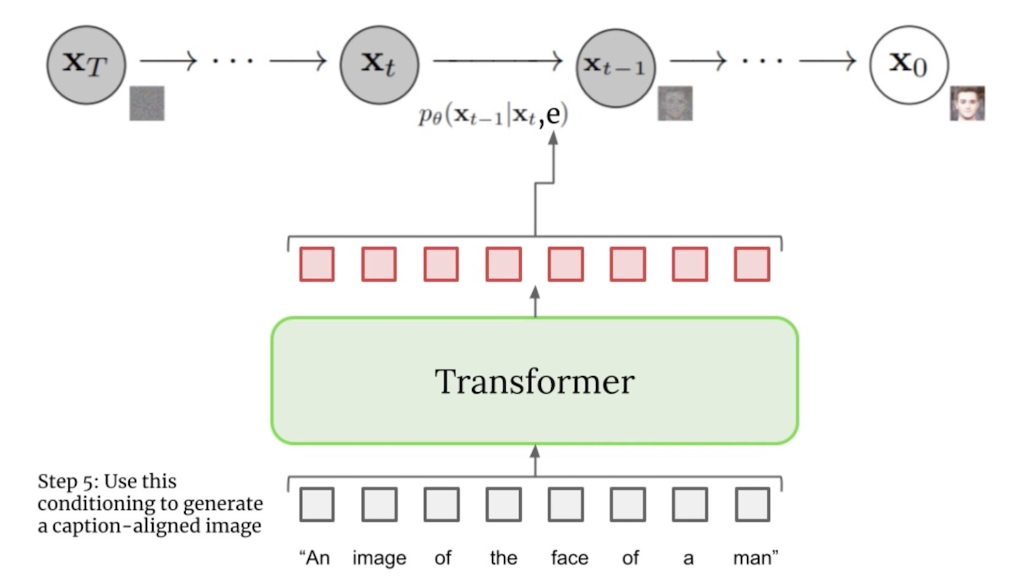
Text Conditioning in Latent Diffusion Models
1. Image Preparation
Image Feature Extraction: The U-Net processes the input image and extracts feature maps.
Reshaping for Attention: The 3D feature maps can be flattened into a 2D format.
2. Text Preparation
Text Embedding Generation: Use a pretrained text encoder to convert the text input into a fixed-length embedding vector.
3. Compute Attention Mechanism between Text and Image Features
Compute Cross-Attention: The cross-attention mechanism computes the relationships between the image features (queries) and the text embeddings (keys and values). For each of the tokens in the image features, attention weights are computed based on the similarity to the text embedding.
Integration of Conditioned Features
The attention output, now containing text-conditioned information, is reshaped back to the original spatial dimensions of the U-Net feature maps. The U-Net processes the conditioned feature maps through its remaining layers to generate the final output image, which is conditioned on the text input.
Notes:
https://eugeneyan.com/writing/text-to-image/

Slide 11
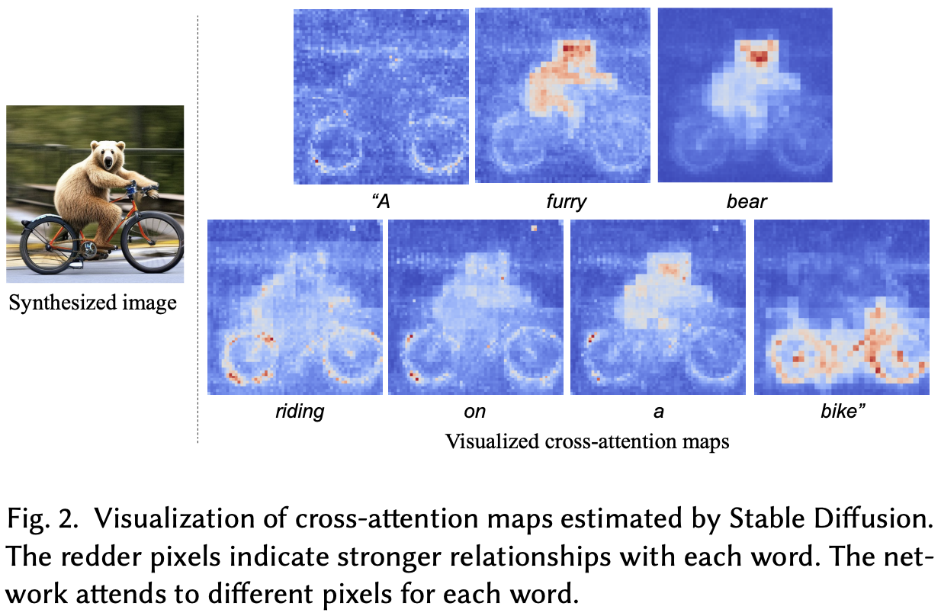
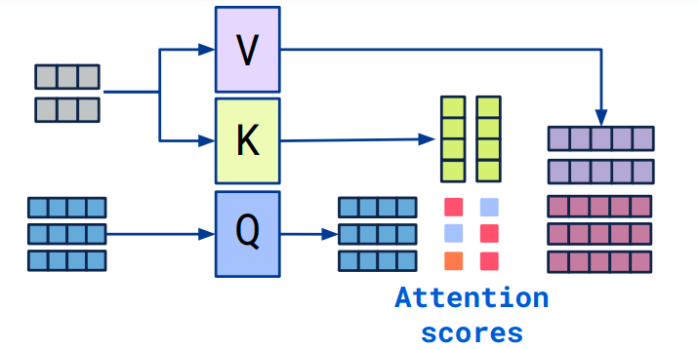
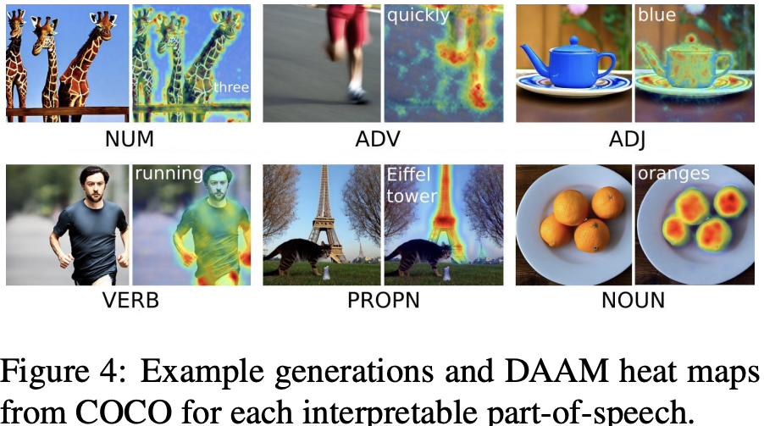
Cross-Attention Mapping – Understanding prompts
We can use the cross-attention mechanism in these latent diffusion models to trace the highest attention for each word in the generated image
From text
From image
Notes:
https://arxiv.org/pdf/2210.04885
https://vaclavkosar.com/ml/cross-attention-in-transformer-architecture
https://arxiv.org/pdf/2308.06027

Slide 12
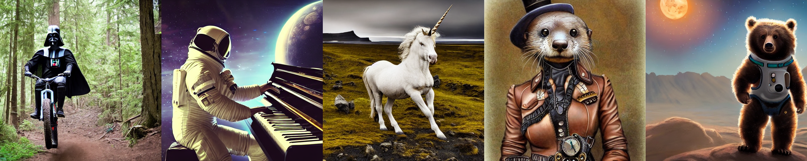
Stable Diffusion
From the developer’s GitHub
Stable Diffusion is a latent text-to-image diffusion model. Thanks to a generous compute donation from Stability AI and support from LAION, we were able to train a Latent Diffusion Model on 512x512 images from a subset of the LAION-5B database. Similar to Google's Imagen, this model uses a frozen CLIP ViT-L/14 text encoder to condition the model on text prompts. With its 860M UNet and 123M text encoder, the model is relatively lightweight and runs on a GPU with at least 10GB VRAM.
Notes:
https://github.com/CompVis/stable-diffusion?tab=readme-ov-file#stable-diffusion-v1

Slide 13
Text-Image Embeddings: CLIP

Slide 14
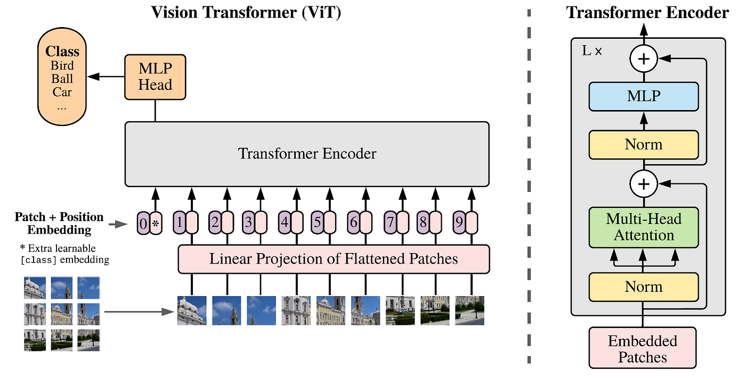
Dual Encodings Text and Images – Why?
In many scenarios, a multi modal interaction is very powerful
This is true not just for the conditional diffusion in LDM but in general Computer Vision tasks.
But how do we combine them?
Text Encodings
Models like BERT and GPT can generate text embeddings
Image Encodings
Convolutional Neural Networks like ResNet can generate a low dimensional representation
Vision Transformers can generate image patch encodings with attention layers
Notes:
https://arxiv.org/pdf/2010.11929

Slide 15
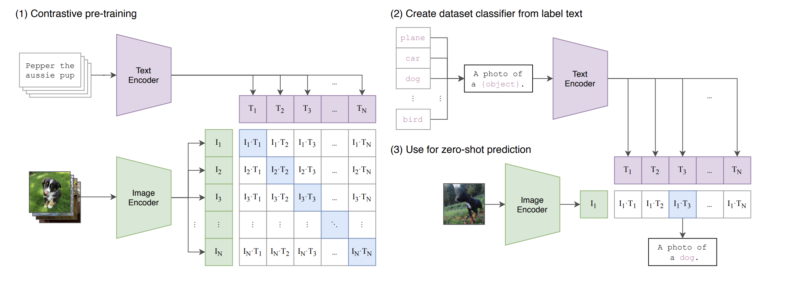
Contrastive Language-Image Pretrained (CLIP)
The Contrastive Language-Image Pretrained (CLIP) Model was developed in 2021 by OpenAI
This model utilizes a text LLM such as GPT and BERT to generate text caption embeddings
These text captions are paired with images that are sent through a Vision Transformer for a shared embedding space
Notes:
https://arxiv.org/pdf/2103.00020

Slide 16
Contrastive Language-Image Pretrained (CLIP) - Training
Contrastive Learning
The primary objective is to learn embeddings where matching text-image pairs are close together, and non-matching pairs are far apart.
Positive and Negative Pairs:
Positive Pairs: Corresponding text and image pairs (e.g., an image of a cat and the caption "a cat").
Negative Pairs: Randomly selected non-matching text and image pairs (e.g., an image of a cat and the caption "a dog").
Contrastive Loss Function:
The model uses a contrastive loss function, such as InfoNCE (Information Noise-Contrastive Estimation), to optimize the alignment of embeddings.
The loss function encourages the embeddings of positive pairs to be close and those of negative pairs to be distant.
Notes:
https://arxiv.org/pdf/2103.00020

Slide 17
Contrastive Language-Image Pretrained (CLIP) - Inference
Zero-Shot Inference
Primarily, CLIP models are used for zero shot predictions of image descriptions
CLIP models do have some limitations, notably, they do not perform well on out of sample images, even struggling with the MNIST handwritten dataset.
Nonetheless, CLIP models, and variants are used extensively in diffusion models as a means to introduce text conditional embedded information to control image generation.
Notes:
https://arxiv.org/pdf/2103.00020

Slide 18
Current State of the Art and the Future

Slide 19



Comparing Diffusion Models
Feature/Aspect | Stable Diffusion | DALL-E | Imagen
Architecture | Latent Diffusion Model (LDM) | Transformer-based | VQ-VAE
Parameters | Approximately 1.3 billion | Approximately 3.5 billion | Not publicly disclosed (likely high)
Image Quality | High | Very High | Very High
Realism | High | High | Very High
Text-Image Alignment | Strong | Very Strong | Very Strong
Training Dataset | 400 million image-text pairs | Not publicly disclosed | JFT-300M (300 million images)
Training Techniques | Advanced noise scheduling | optimized sampling | Sparse attention
Computational Efficiency | High | Moderate | Moderate
Flexibility | High | High | Moderate
Scalability | High | Moderate | Moderate
Zero-Shot Learning | Strong generalization to new prompts | Excellent zero-shot capabilities | Strong zero-shot capabilities
Use Cases | Text-to-image synthesis | image inpainting | super-resolution
Notable Strengths | Efficient and scalable | high-quality outputs | versatile
Availability | Open-source (various implementations) | Limited access | not fully open-source
Notes:
https://stability.ai/
https://openai.com/index/dall-e-3/
https://imagen.research.google/

Slide 20
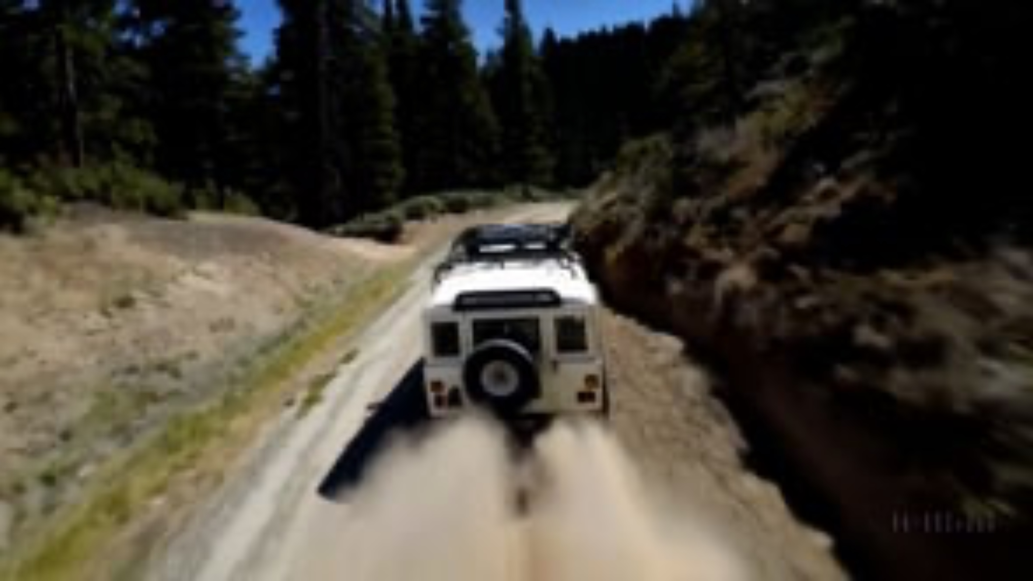
Video Diffusion Models
Open AI announced Sora, a video generation model, signaling the next stage of diffusion generative AI…
Prompt: The camera follows behind a white vintage SUV with a black roof rack as it speeds up a steep dirt road surrounded by pine trees on a steep mountain slope, dust kicks up from it’s tires, the sunlight shines on the SUV as it speeds along the dirt road, casting a warm glow over the scene. The dirt road curves gently into the distance, with no other cars or vehicles in sight. The trees on either side of the road are redwoods, with patches of greenery scattered throughout. The car is seen from the rear following the curve with ease, making it seem as if it is on a rugged drive through the rugged terrain. The dirt road itself is surrounded by steep hills and mountains, with a clear blue sky above with wispy clouds.
Notes:
https://openai.com/index/video-generation-models-as-world-simulators/

Slide 21
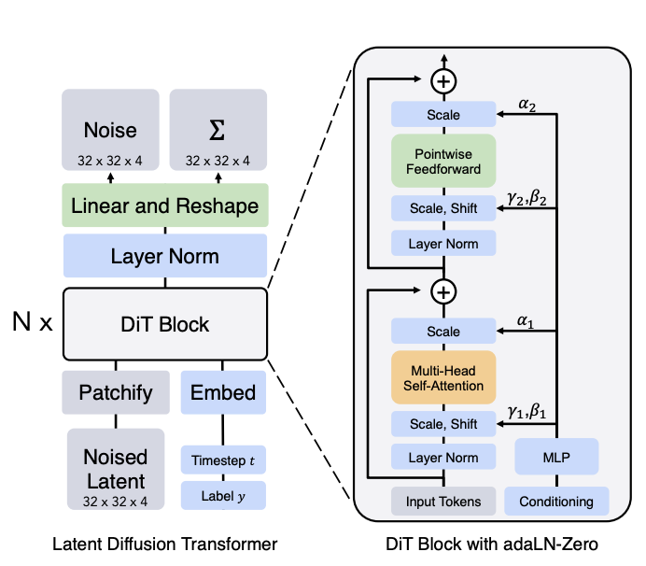
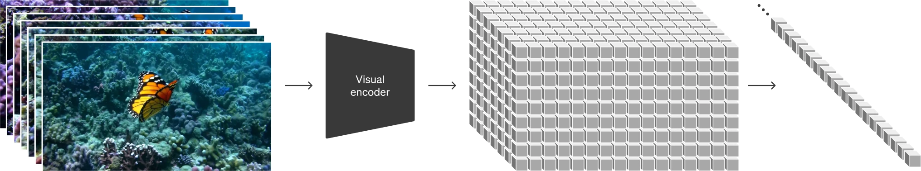
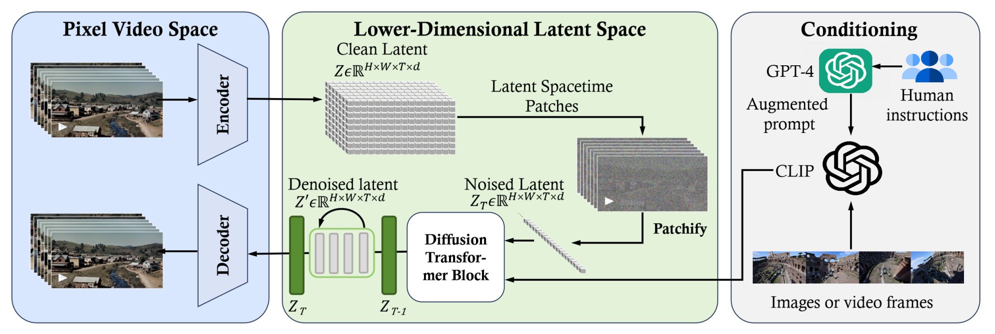
Video Diffusion Models
Diffusion Transformer
Current Models (mid 2024)
Sora
OpenSora
Runway Gen-2
Pika
Sora/OpenSora
Notes:
https://hpc-ai.com/blog/open-sora
https://openai.com/index/video-generation-models-as-world-simulators/
https://arxiv.org/pdf/2212.09748

Slide 22
Working with Diffusion Models

Slide 23

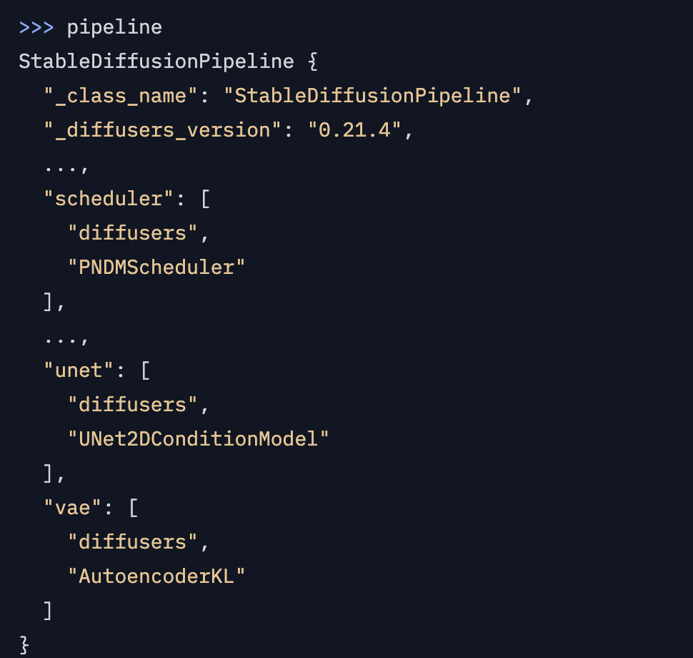
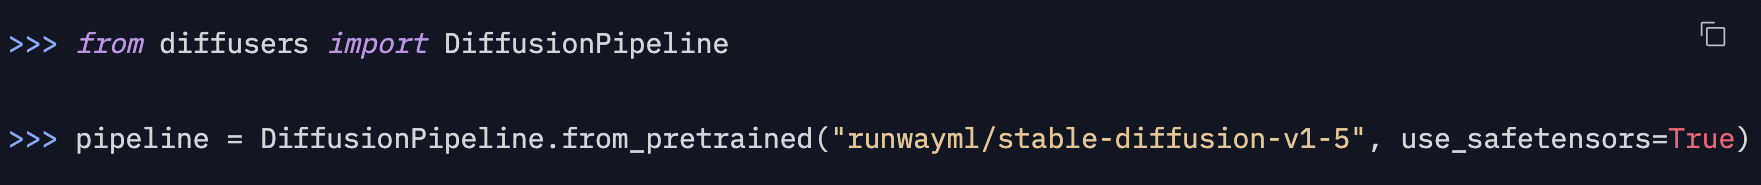
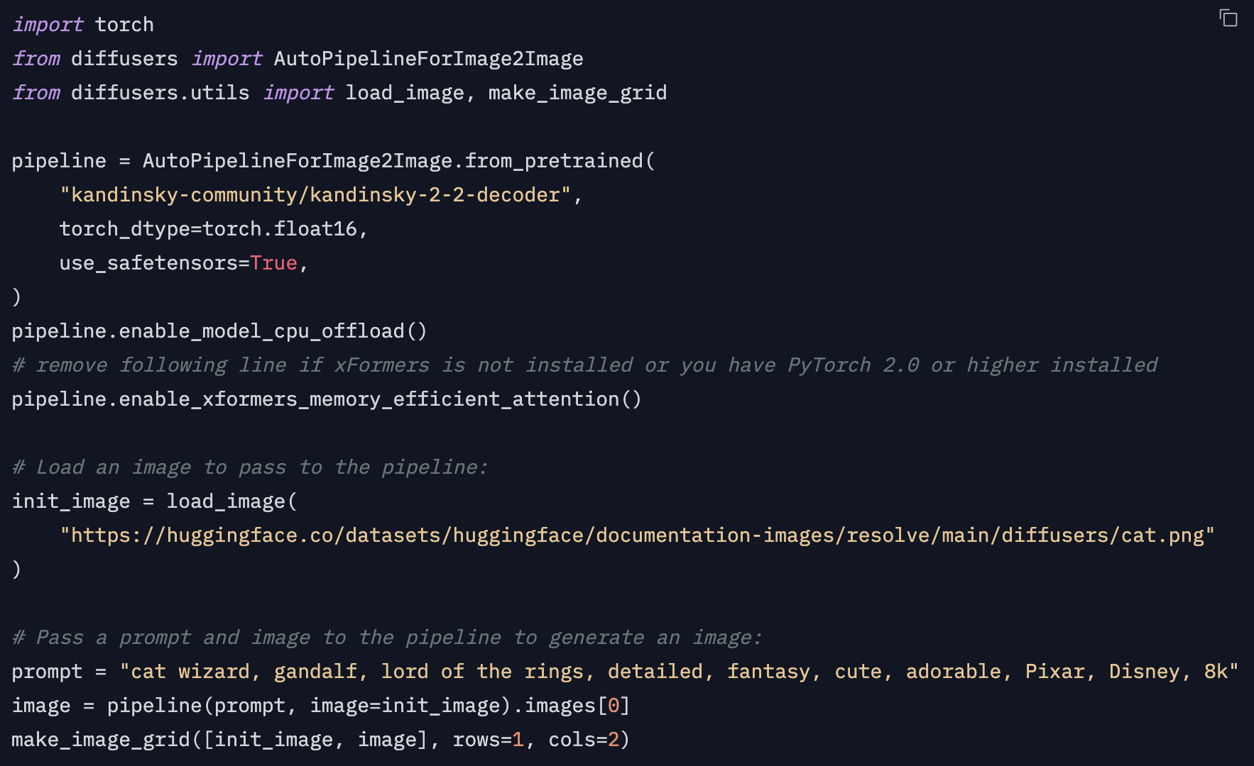
Hugging Face Diffusers
Similar to LLMs, Hugging Face provides an API to interact with open-source diffusion model.
Image generation from text:
Image generation from another image:

Slide 24
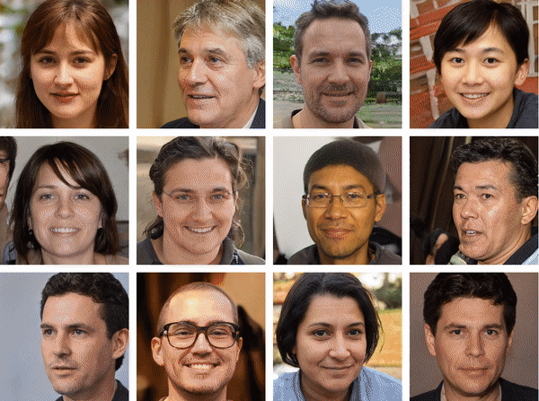
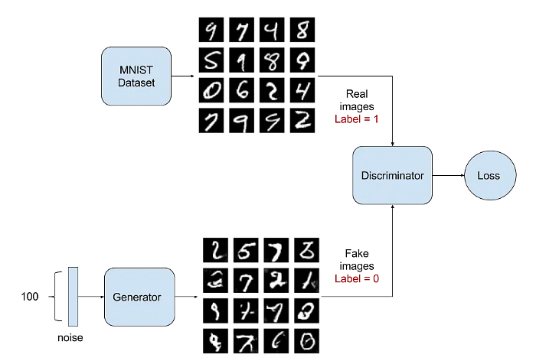
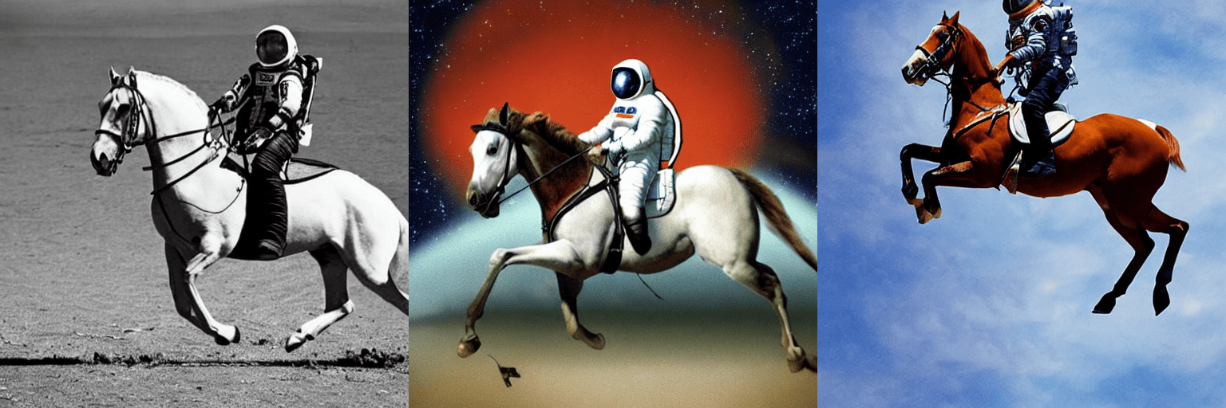
Diffusion and Image Generation – Wrap Up
In this module we have introduce the generative models that focus on image generation:
Generative Adversarial Networks
Diffusion Models
Latent Diffusion Models

Slide 25
Thank you!

